Slide 1
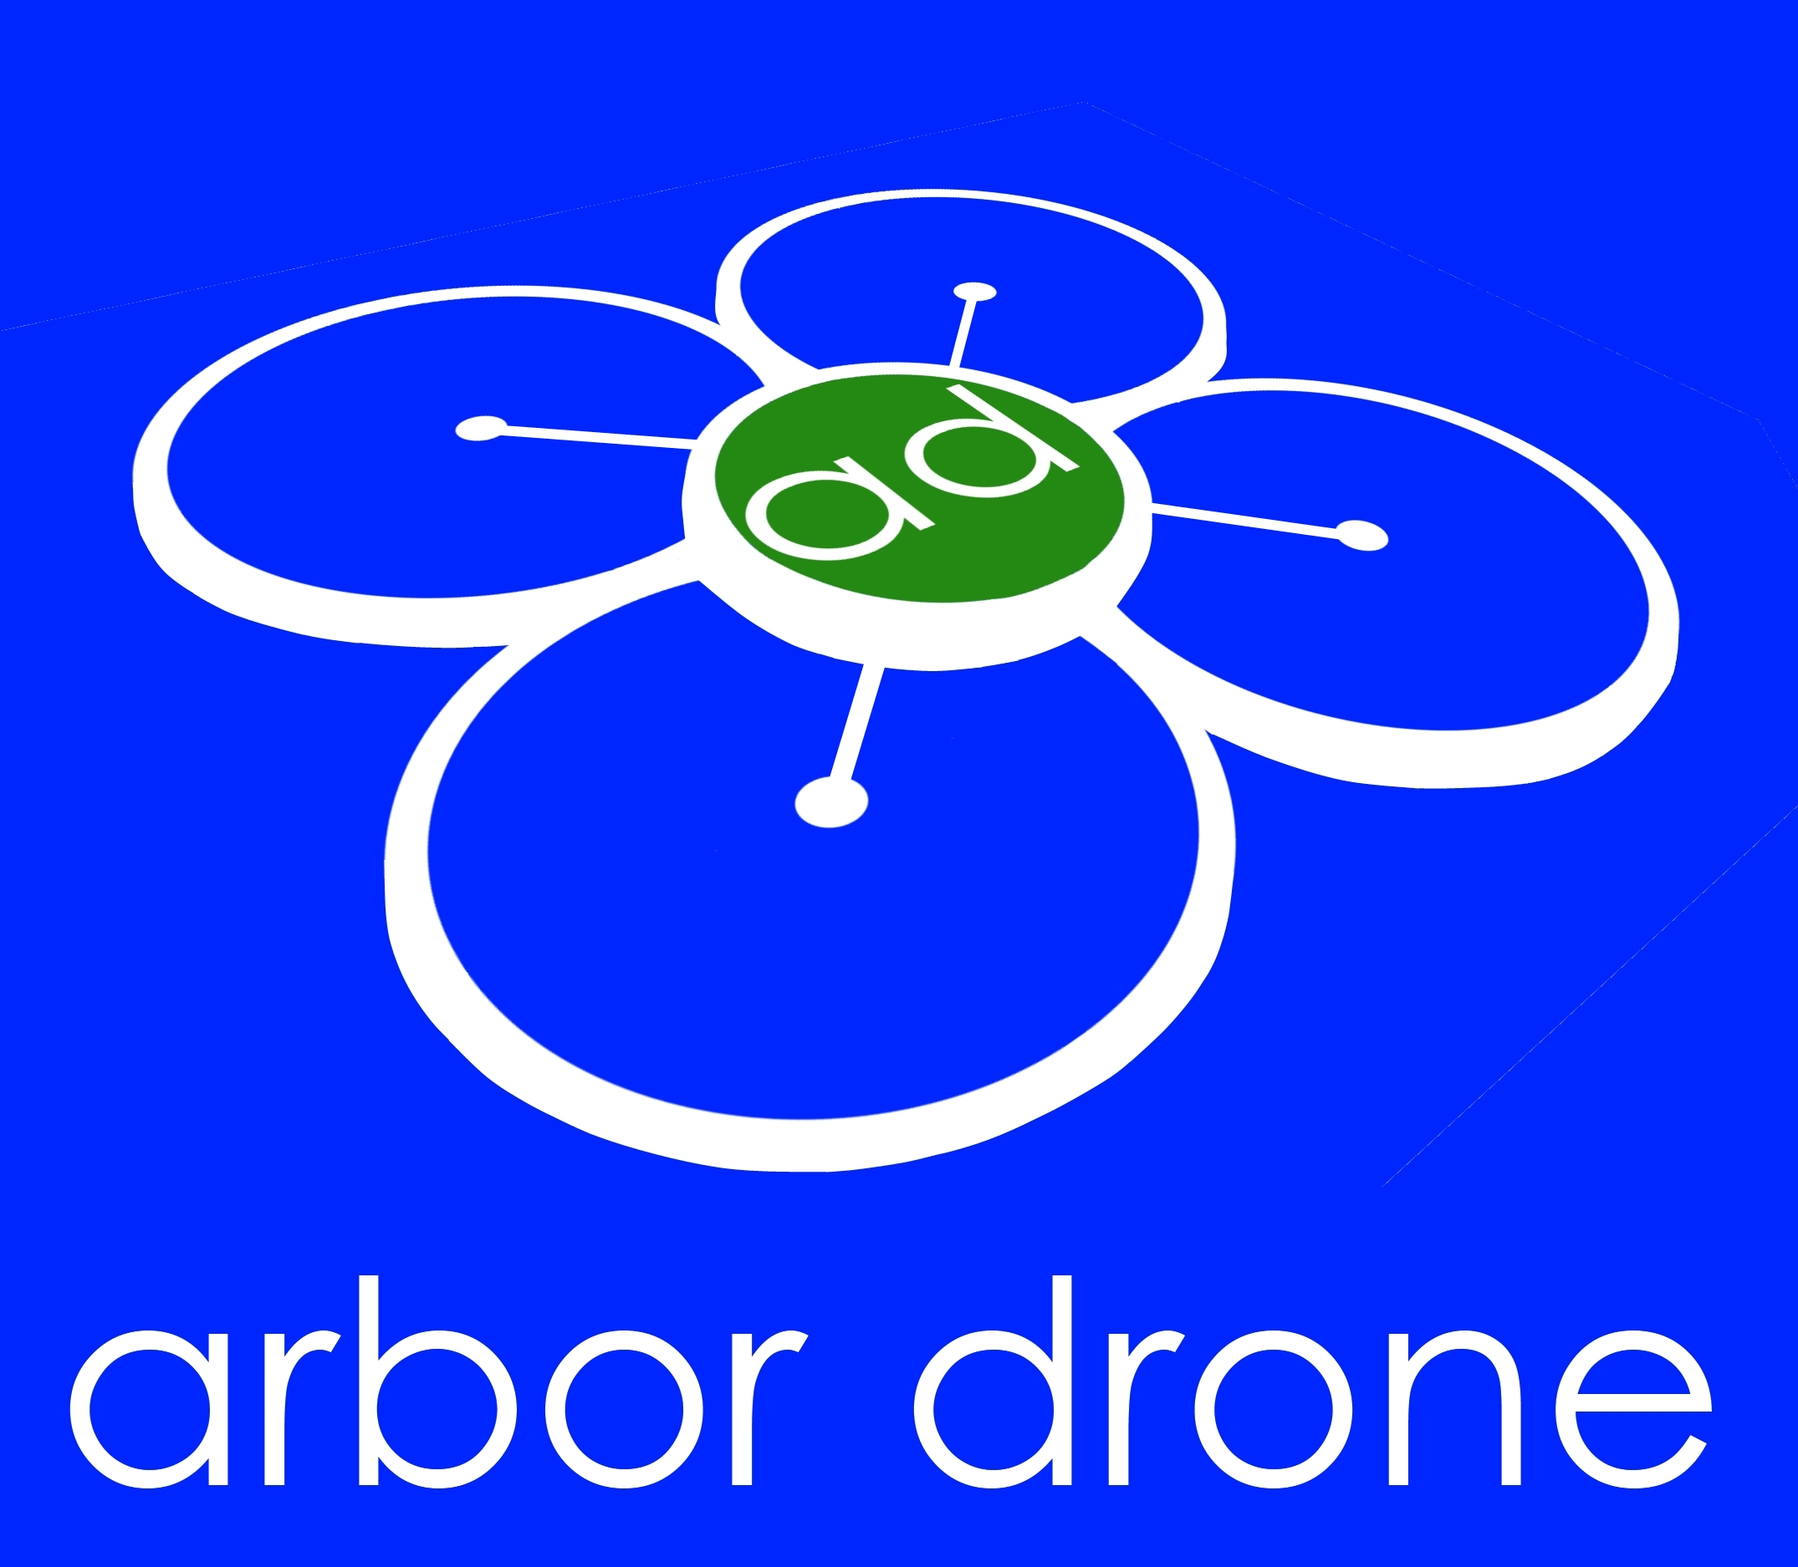
Detecting Emerald Ash Borer with UAVs and Multispectral Sensors in Denver, Colorado
Tim Haynie
thaynie@spectrabotics.com
AUVSI Xponential
May 2, 2018
1:00-1:30 Room 203
Dan Staley
dan@arbordrone.net

Slide 2
Data Collector
Data Services
Subject Matter
Expert

Slide 3
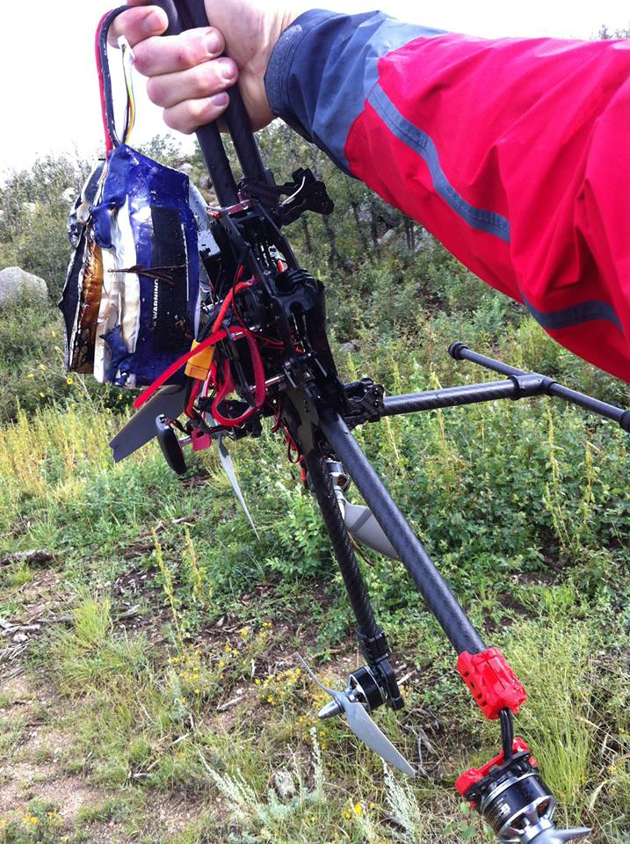
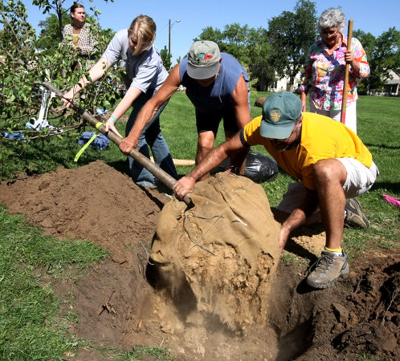
Why Dan and Tim?
Stick to What You Are Good At Doing

Slide 4
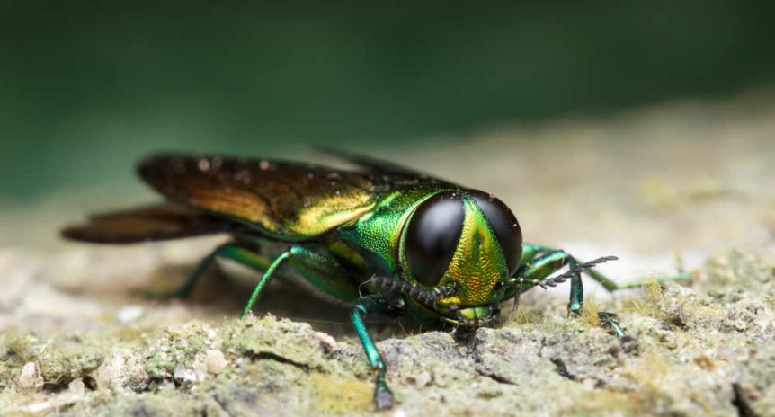

Slide 5
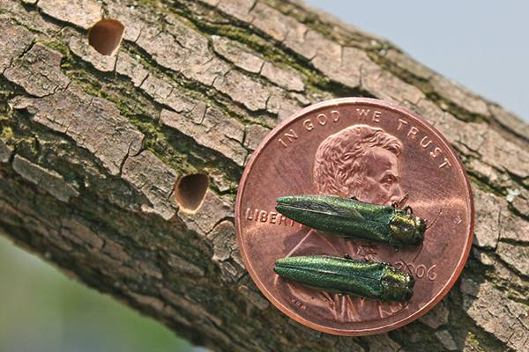

Slide 6
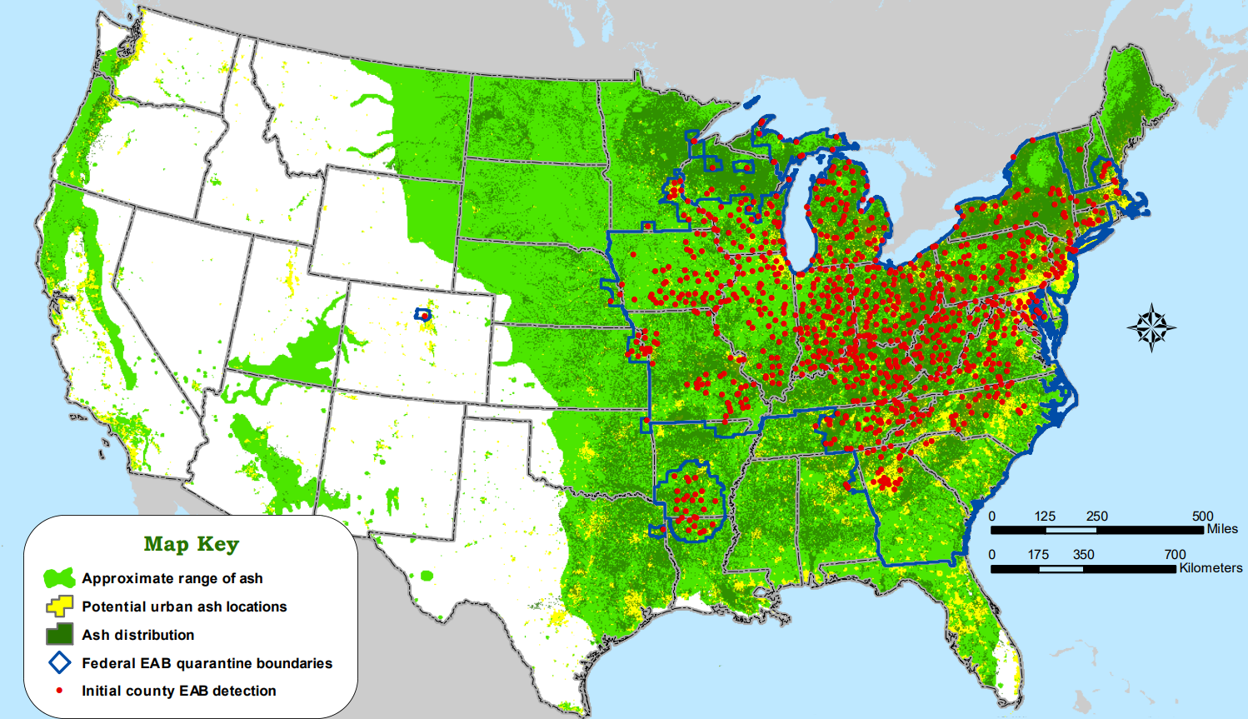
Potential to destroy 90-95% of all Ash trees in North America
Colorado Front Range urban forest: 1 in 6 trees are Ash

Slide 7
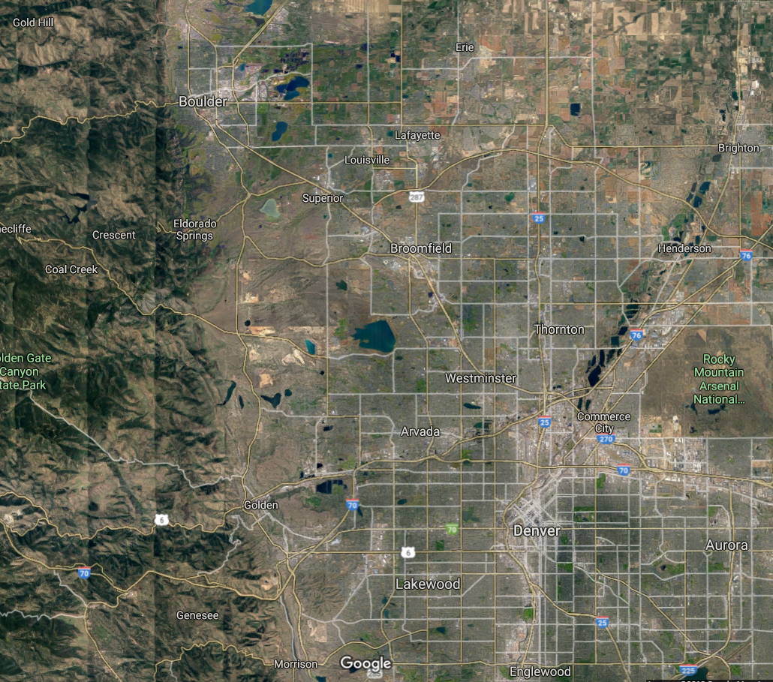
Proof of Concept with City of Denver
Introduce new technology to identify Emerald Ash Borer infestation
Develop algorithms and classifications to isolate EAB affected ash trees
Automate the process
Quarantine
Zone
30 Miles

Slide 8
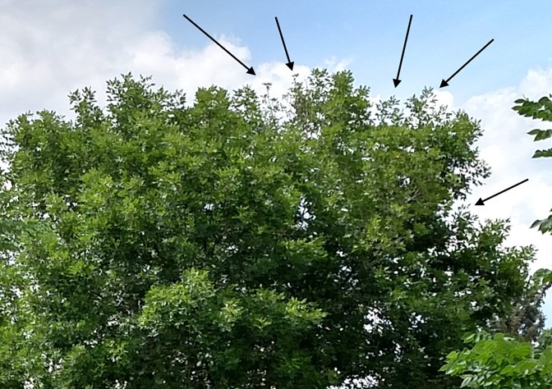
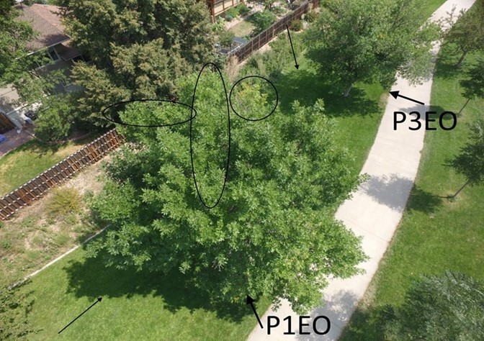
Goals
Find This

Slide 9
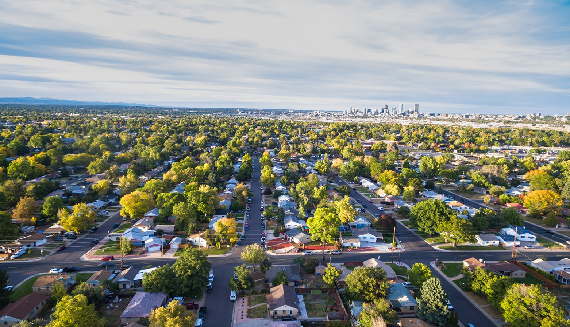
Goals
In This

Slide 10
Goals
Early identification and monitoring of Emerald Ash Borer infestation
Develop algorithms and classifications quantifying stress levels and identifying tree species, moving towards automation
Develop replicable procedures/analysis for future projects

Slide 11
Project Design
Fly parks, Rights of Way in City/County of Denver to obtain sample of tree species (including ash)
Micasense RedEdge sensor mounted on custom octocopter
Choose Vegetation Indices to best identify early infestation
Statistical analysis for tree species

Slide 12
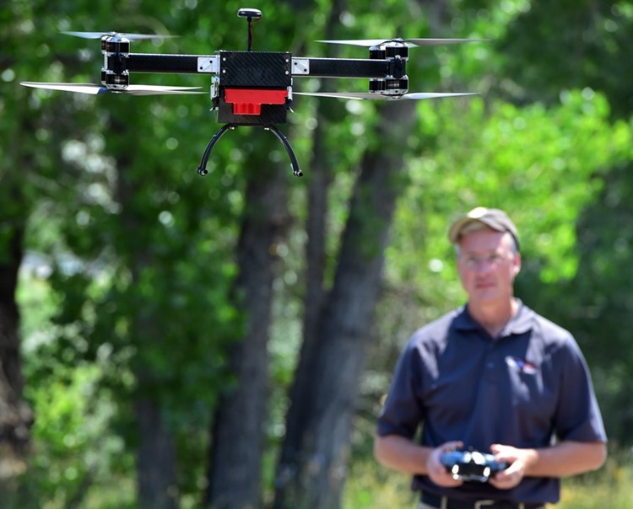
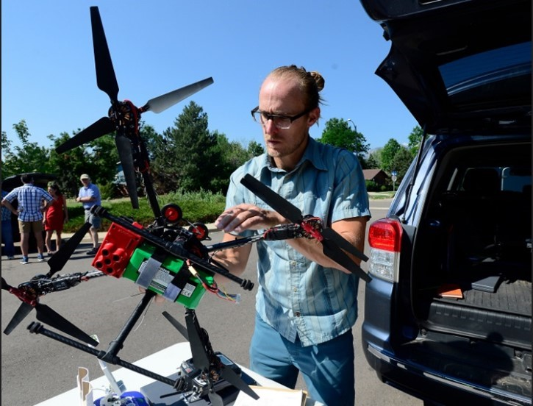
Aircraft & Equipment
Darren Ceckanowitz
Custom UAS
Tim Haynie
Custom UAS

Slide 13
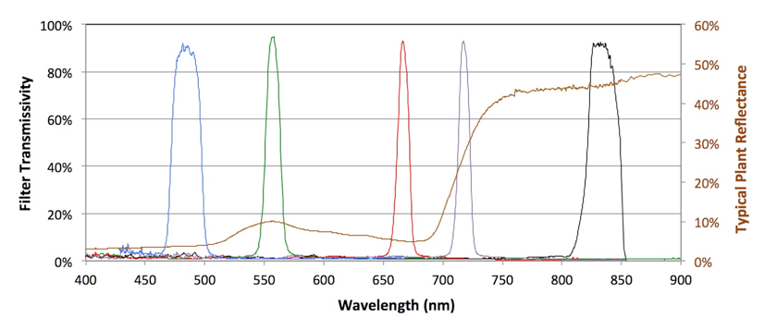
Plant Physiology and Early Detection

Slide 14
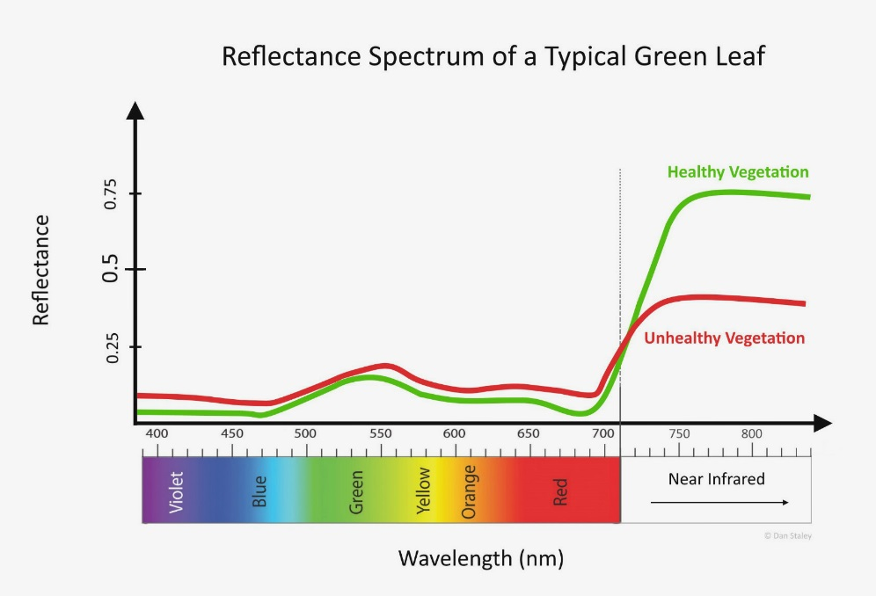
Plant Physiology and Early Detection

Slide 15
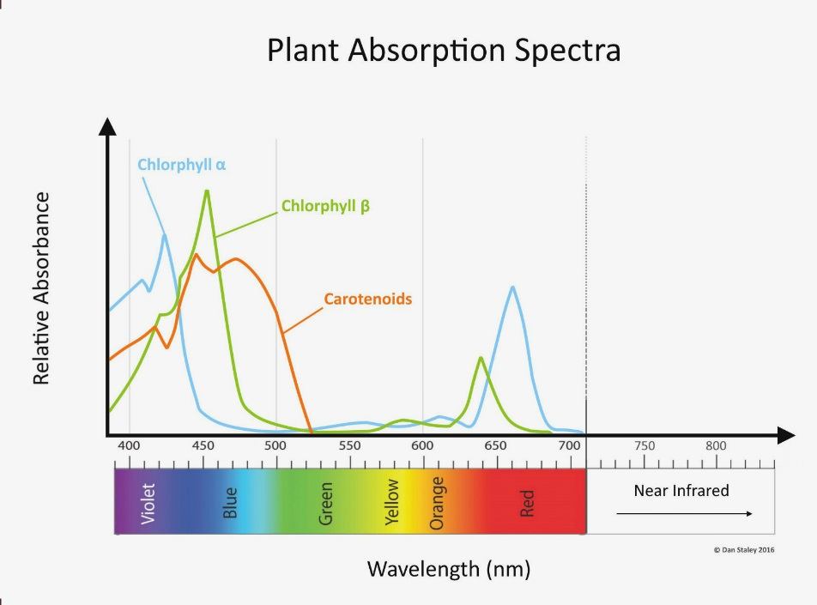
Plant Absorption Spectra

Slide 16
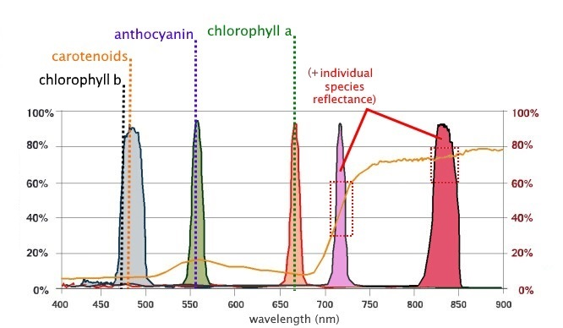
Plant Physiology and Early Detection

Slide 17
Early Detection Criteria
Consider tree physiology and reaction to manipulate reflectance values in useful analysis
Vegetation Indices (Band Math) choice depends on what you want to look for
1.5 [2.5( - ) - 1.3( - )]
Modified Chlorophyll Absorption In Reflection Index
800
670
800
550
=
(2 * +1) - (6 * - 5* ) - 0.5
800
800
670

Slide 18
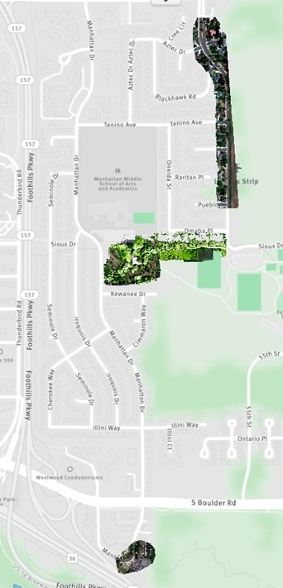
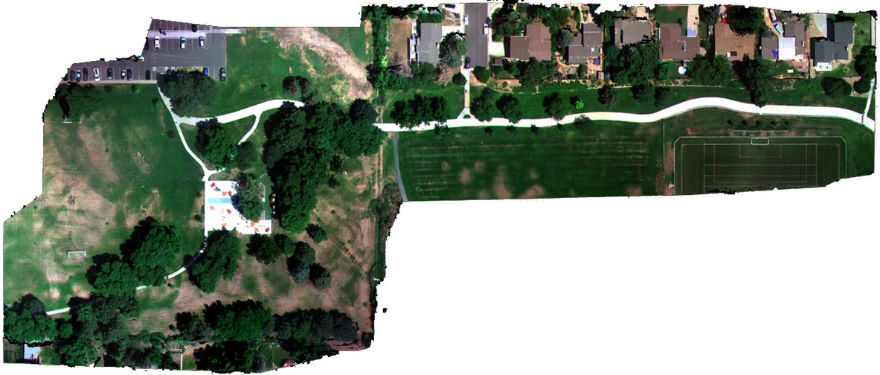
First, How to Find EAB

Slide 19
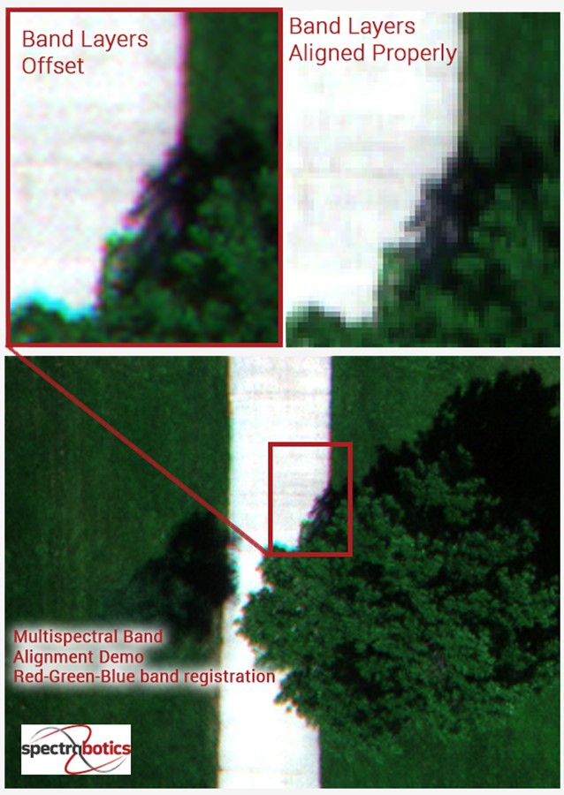
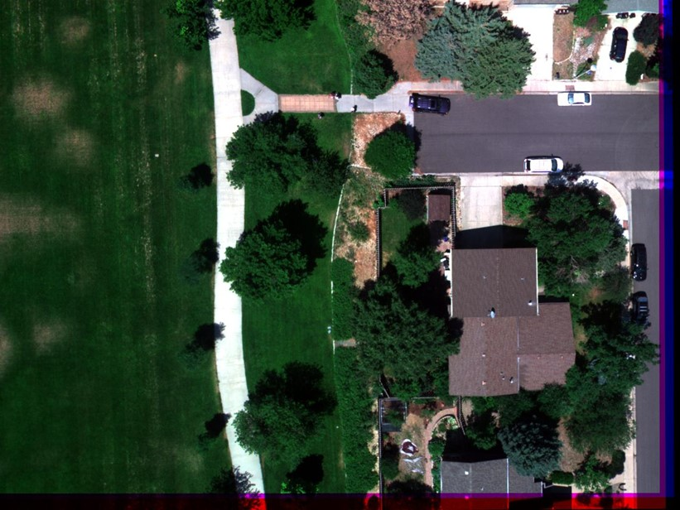

Slide 20
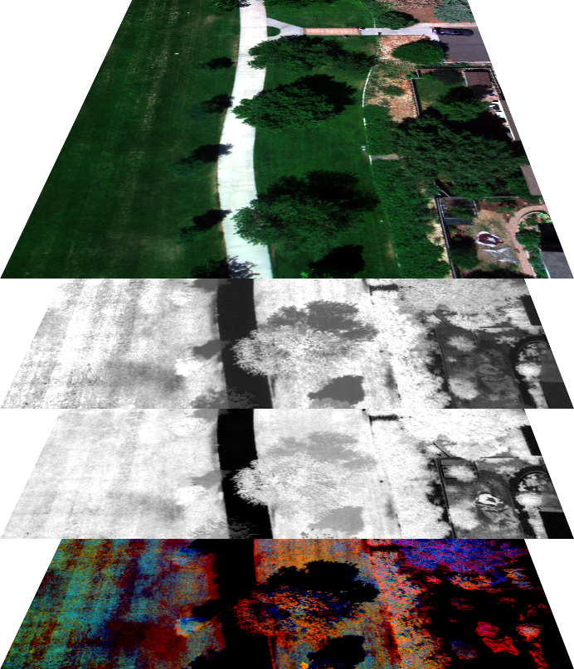
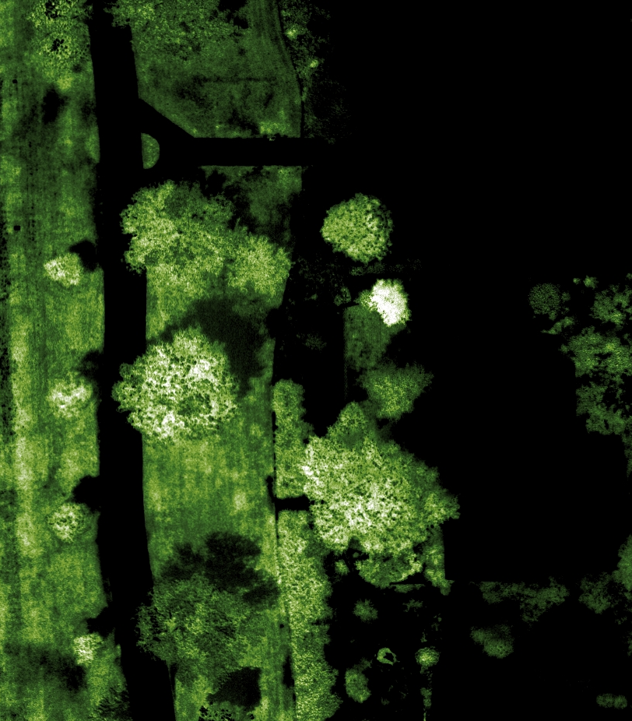
Color-Enhanced Green Normalized Difference Vegetation Index

Slide 21
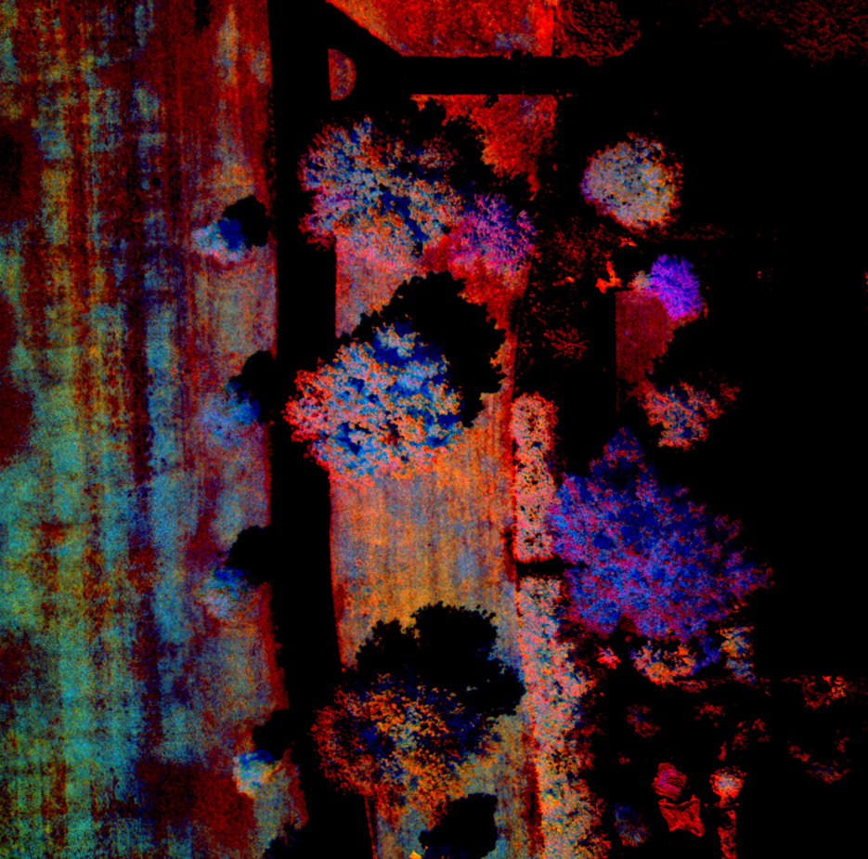
EAB Indicators

Slide 22
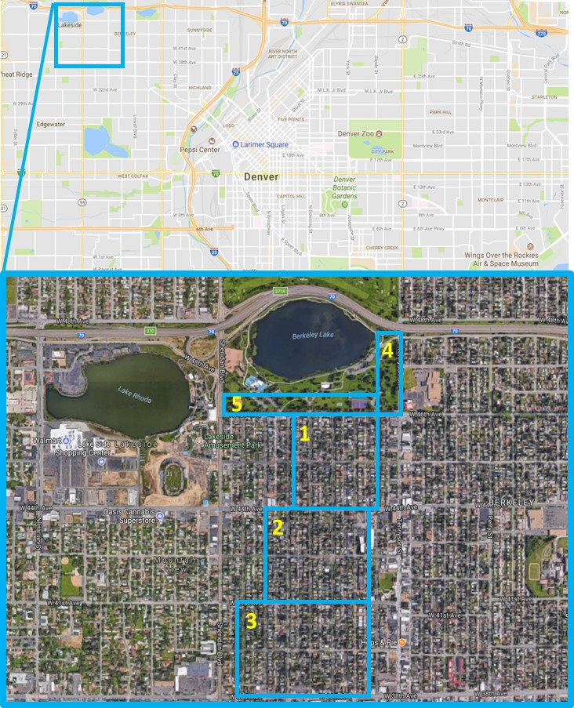
Data Collection: Denver
Distance Flown (m) | 17,198
Area Covered (sq/m) | 668,869
Trees Imaged | 1628

Slide 23
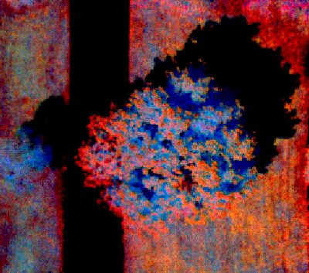
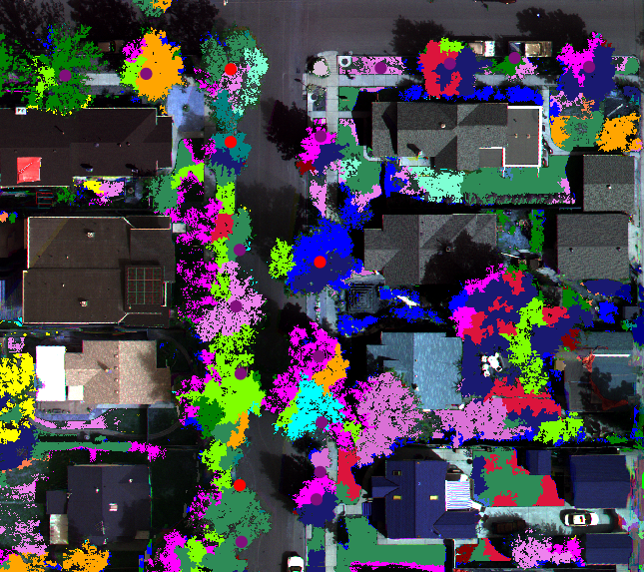
Seeking to Improve Species ID with Machine Learning
Bur Oak White Ash
Japanese Pagoda Tree Zelkova Bur Oak
Green Ash
White Ash
Bur Oak
Green Ash
Western Catalpa
Silver Maple
Kentucky Coffee Tree
American Linden
Bur Oak
White Oak
Key Indicators of Infestation
Combination of Analytics
Automated Analysis Coming!
Northern Red Oak
White Ash
Honey Locust

Slide 24
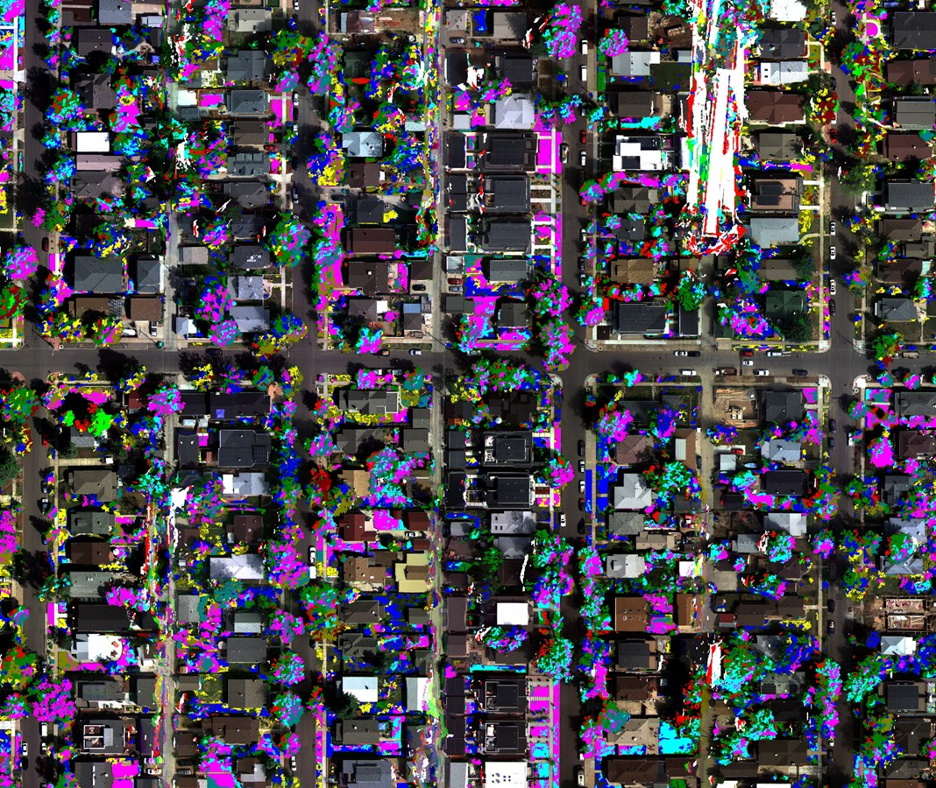
Other Uses for the Data?
Roads, roofs, yards
Environmental monitoring
Transportation studies

Slide 25
Write This Down
UAS companies play a critical role for Data Collection
Project revenues go UP for high-end analysis
Get on a team and get involved in the planning

Slide 26
Data Collector
Subject Matter Expert
Data Services

Slide 27
https://arbordrone.net/
www.spectrabotics.com
Dan Staley
Principal
dan@arbordrone.net
Tim Haynie
Founder – CEO
thaynie@spectrabotics.com

